Slide 1
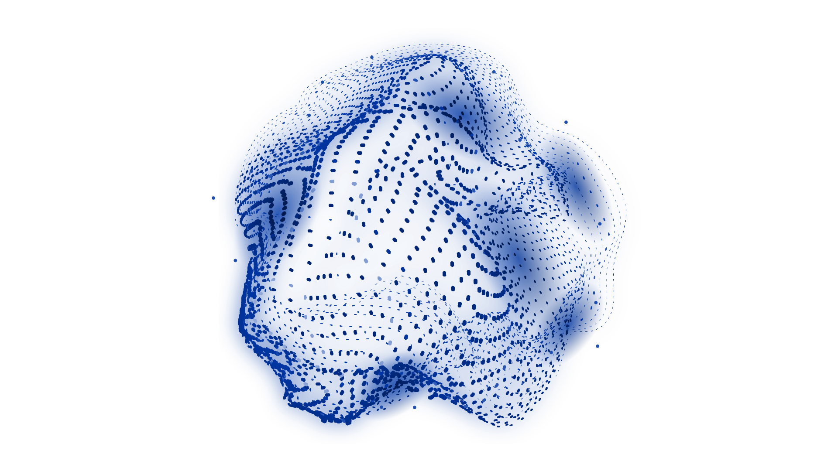
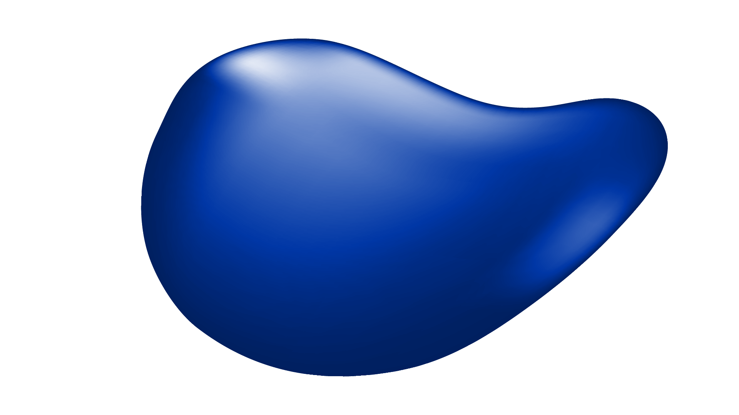
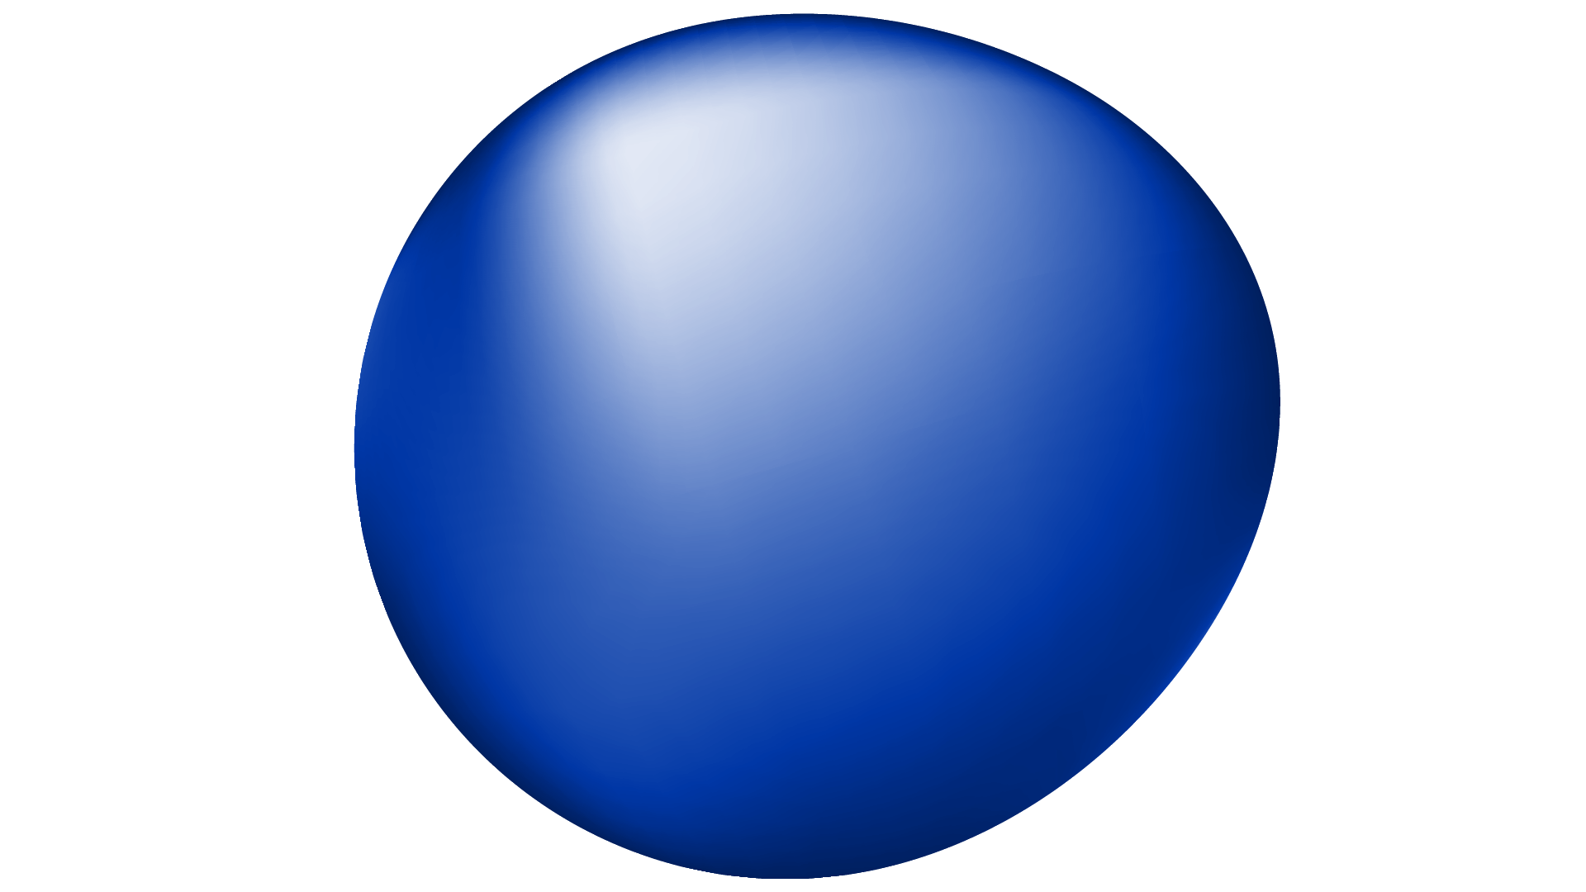
RANDOM WALK APPROACHES TO MACHINE LEARNING OF NETWORKS
PROJECT PRESENTATION
Michigan State University

Slide 2
TABLE OF CONTENTS
01
02
03
04
05
NETWORK EMBEDDING
DEEPWALK
NODE2VEC
EXPERIMENTS AND EVALUATION
FUTURE DIRECTIONS

Slide 3
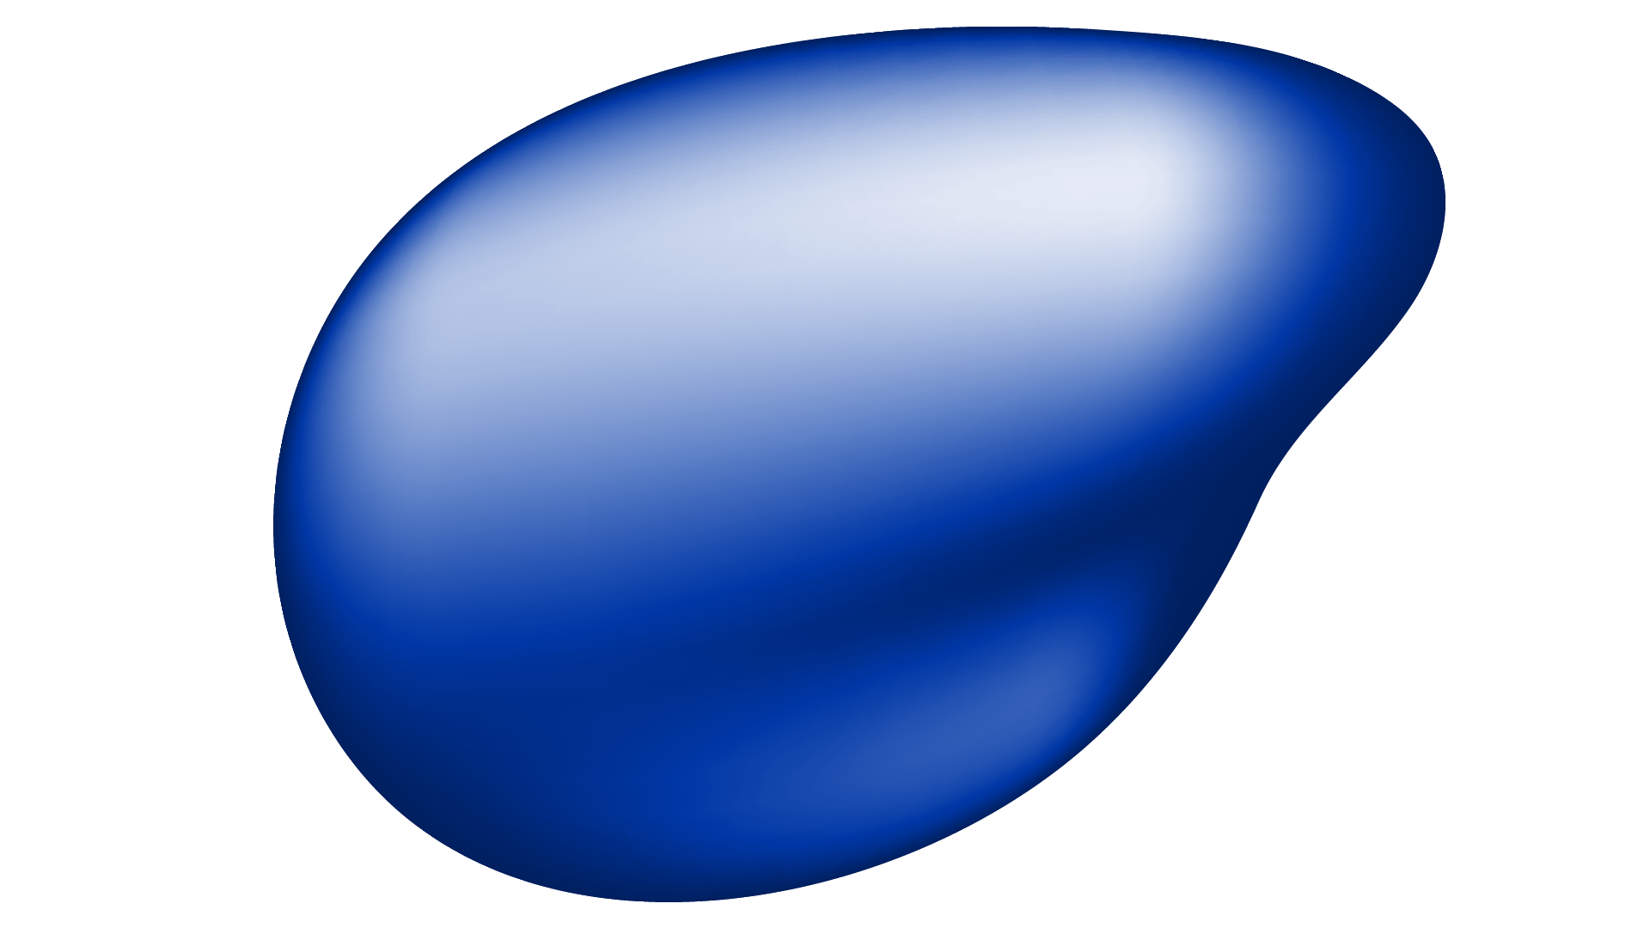
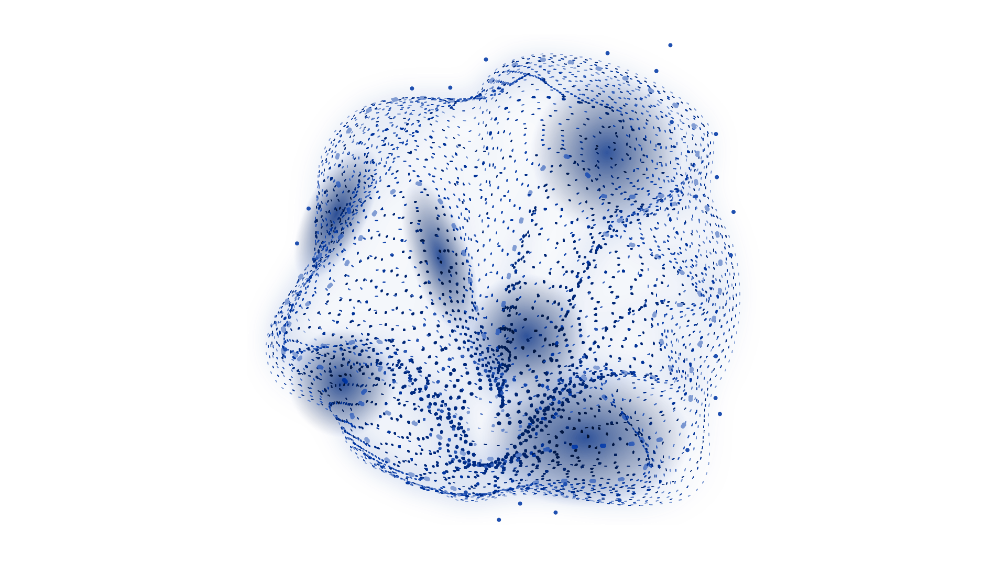
01
NETWORK EMBEDDING

Slide 4
Understanding Graphs for Representation Learning
Visualizes relationships between the data
Consists of:
1. Nodes: capture data as vectors
2. Edges: connect related nodes
Representation Learning extracts hidden features from the graph for complex analysis.
e.g. link prediction, node classification, community detection.
1
5
2
8
3
7
6
4

Slide 5
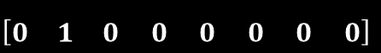
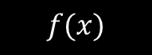
Understanding Graphs for Representation Learning
$$\left[\begin{matrix}0 & 1 & 0 0 0 0 0 0\end{matrix}\right]$$
Ajay
5
.
.
1
2
.
$$f(x)$$
.
8
.
.
.
3
.
7
6
4

Slide 6
Analyzing Graphs with Random Walk
end
1
5
2
Choose starting point and steps
Determine probabilities based on neighbor nodes
Collect data from walks
8
1/3
3
7
6
1/3
start
1/3
4
7
8
2
8
2
Steps = 5

Slide 7
SkipGrams and their relation to DeepWalk
NLP model: words in sentence context
Applied on the paths to maximize the probability of observing a node's neighborhood
Nodes with similar neighborhood share similar embeddings
The objective function of DeepWalk is the following cross entropy:
W is the window size which restricts the size the random walk context

Slide 8
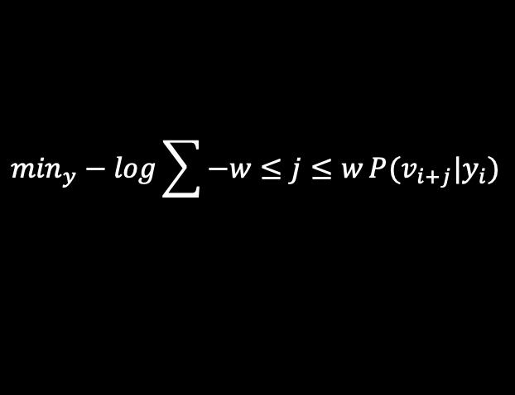
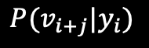
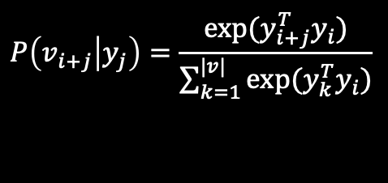
The meaning and transformation of the SkipGram formula
Looking back at the previous formula,
SkipGram removes the ordering constraint
In the end, it will be transformed into:
Conditional probability defined using the softmax function:

Slide 9
02 DeepWalk

Slide 10
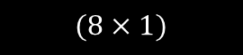
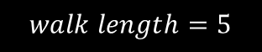

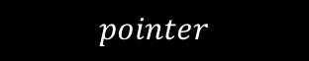
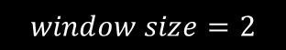
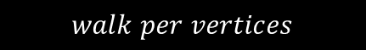
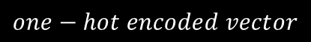
How DeepWalk Works
Step 1: Random Walk
Step 2: One-hot encoding
$$(8×1)$$
$$\left[\begin{aligned}0 \\ 1 \\ 0 \\ 0 \\ 0 \\ 0 \\ 0 \\ 0\end{aligned}\right]$$
start
2
1
5
One - hot encoding
2
8
end
2
8
6
3
7
4
6
7
4
3
$$one−hot encoded vector$$
$$walk length=5$$
$$window size=2$$
$$walk per vertices$$
$$pointer$$

Slide 11
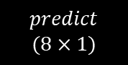
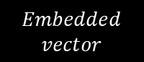
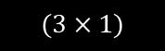
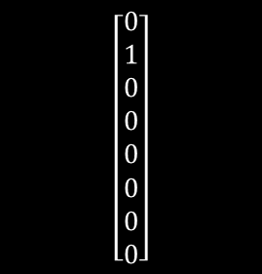
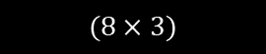
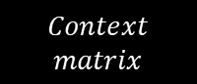
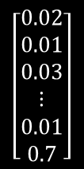
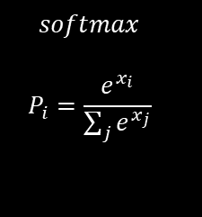
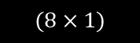
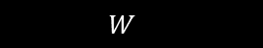
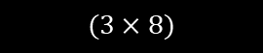
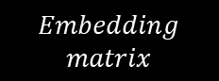
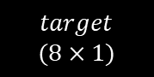
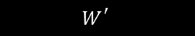
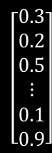
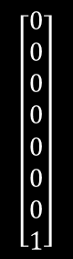
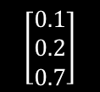
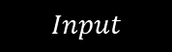
How DeepWalk Works
Step 3: Implement Skip-gram model
Encoder
Decoder
$$target$$
$$(8×1)$$
2
$$predict$$
$$(8×1)$$
$$(8×1)$$
$$(8×1)$$
$$\left[\begin{aligned}0 \\ 1 \\ 0 \\ 0 \\ 0 \\ 0 \\ 0 \\ 0\end{aligned}\right]$$
$$\left[\begin{aligned}0 \\ 0 \\ 0 \\ 0 \\ 0 \\ 0 \\ 0 \\ 1\end{aligned}\right]$$
$$(3×1)$$
$$\left[\begin{aligned}0.3 \\ 0.2 \\ 0.5 \\ ⋮ \\ 0.1 \\ 0.9\end{aligned}\right]$$
$$\left[\begin{aligned}0.02 \\ 0.01 \\ 0.03 \\ ⋮ \\ 0.01 \\ 0.7\end{aligned}\right]$$
$$softmax$$
$$P_{i}=\frac{e^{x_{i}}}{\sum_{j}{e^{x_{j}}}}$$
$$W_{}$$
$$\left[\begin{aligned}0.1 \\ 0.2 \\ 0.7\end{aligned}\right]$$
$$W_{}^{′}$$
$$(8×3)$$
8
$$(3×8)$$
$$Embedded$$
$$vector$$
$$Embedding$$
$$matrix$$
$$Context$$
$$matrix$$
$$Input$$
2
8
6
4
7
3

Slide 12
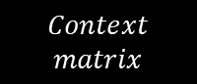
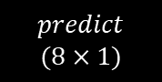
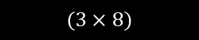
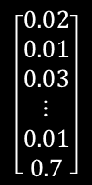
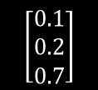
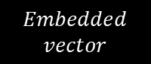


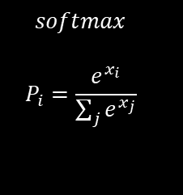
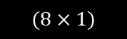
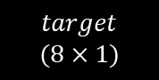
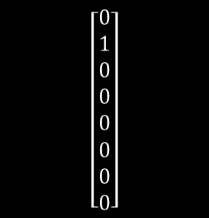
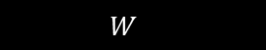
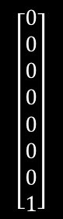
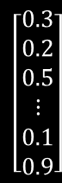
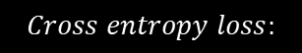
How DeepWalk Works
Step 3: Implement Skip-gram model
$$target$$
$$(8×1)$$
2
$$predict$$
$$(8×1)$$
$$(8×1)$$
$$(8×1)$$
$$\left[\begin{aligned}0 \\ 1 \\ 0 \\ 0 \\ 0 \\ 0 \\ 0 \\ 0\end{aligned}\right]$$
$$\left[\begin{aligned}0 \\ 0 \\ 0 \\ 0 \\ 0 \\ 0 \\ 0 \\ 1\end{aligned}\right]$$
$$(3×1)$$
$$\left[\begin{aligned}0.3 \\ 0.2 \\ 0.5 \\ ⋮ \\ 0.1 \\ 0.9\end{aligned}\right]$$
$$\left[\begin{aligned}0.02 \\ 0.01 \\ 0.03 \\ ⋮ \\ 0.01 \\ 0.7\end{aligned}\right]$$
$$softmax$$
$$P_{i}=\frac{e^{x_{i}}}{\sum_{j}{e^{x_{j}}}}$$
$$W_{}$$
$$\left[\begin{aligned}0.1 \\ 0.2 \\ 0.7\end{aligned}\right]$$
$$W_{}^{′}$$
$$(8×3)$$
8
$$(3×8)$$
$$Embedded$$
$$vector$$
$$Embedding$$
$$matrix$$
$$Context$$
$$matrix$$
$$Input$$
$$Cross entropy loss:$$

Slide 13
Why SkipGrams for DeepWalk?
SkipGrams
DeepWalk
Application: Texts
Context: Relationships of words in a sentence
The quick brown fox jumps over the lazy dog
Application: Graphs
Context: Relationships of nodes in Random Walks
Teacher A – Student B
Student B – Student C
Similarities:
DeepWalk adapts SkipGram from natural language processing to graph data.

Slide 14
03 Node2Vec

Slide 15
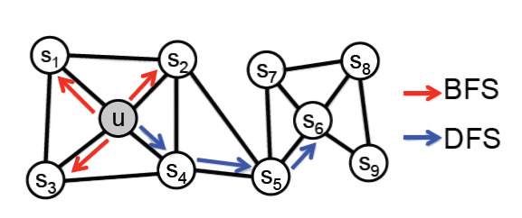
How Node2Vec Works
DeepWalk
1
5
2
Node2Vec is almost similar to DeepWalk
Both methods use:
1. Random walks
2. Skipgram model
Node2Vec have different walk algorithm to collect nodes
Node2Vec either explores data in wide range or far range
8
3
7
6
4
Node2Vec

Slide 16
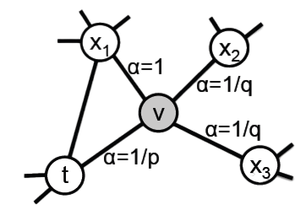



How Node2Vec Works
Current walk: t $→$ v
Determine probability of v $→$ x
Parameter $α_{pq}\left(t,x\right)$ is introduced, where:
$α_{pq}\left(t,x\right)=\left\{\begin{aligned}\frac{1}{p} if d_{tx}=0 \\ 1 if d_{tx}=1 \\ \frac{1}{q} if d_{tx}=2\end{aligned}\right.$
$p$ controls likelihood of revisiting a node
$q$ controls likelihood of walking further or locally

Slide 17
DeepWalk & Node2Vec
DeepWalk
Node2Vec
1
5
2
8
3
7
6
4
Explores data randomly
Low computational cost
Ignores important data
Flexibility
Higher computational cost
Analyze relationships better

Slide 18

Effect of p and q in Node2Vec
Step 1: Prepare dataset (Les Misérable Network)
Contains 77 nodes, 254 edges
Nodes: characters from Les Misérable novel
Edges: relationships between characters

Slide 19



Effect of p and q in Node2Vec
Step 2: Adjust different p and q
Set $p=1, q=0.5$
Set $p=1, q=2$

Slide 20




Effect of p and q in Node2Vec
Step 3: Analyze results
Set $p=1, q=0.5$
Set $p=1, q=2$
$p≫q:$ deep exploration
Homophily community
$p≪q:$ broad exploration
Structural equivalence

Slide 21
04
EXPERIMENTS AND EVALUATION

Slide 22



Experiments
$$f:u→ℝ^{d}$$
Vector
Downstream Tasks
Node
$$u$$
Node classification
Link prediction
Graph classification
Anomalous node detection
Clustering
….
$$ℝ^{d}$$
Sufficient semantic information
Homophily community
structural equivalence

Slide 23



Game of Thrones

Slide 24

From Book to Network
Data
Source | Target | weight
Addam-Marbrand | Jaime-Lannister | 3
Addam-Marbrand | Tywin-Lannister | 6
Aegon-I-Targaryen | Daenerys-Targaryen | 5
Aegon-I-Targaryen | Eddard-Stark | 4
… | … | …
Number of nodes: 187
Number of edges: 684
Link two characters each time their names appear within 15 words.

Slide 25

Pre-processing-visualize
Import unweighted graph
nx.spring_layout(G)

Slide 26
Processing-DFS
Node2Vec
(G,
dimensions=32,
p=5,
q=0.5,
walk_length=10,
num_walks=600,
workers=4)
DFS depth-first search

Slide 27


Processing-DFS
DFS depth-first search,
find homogeneous communities
array([-0.36179334, -0.11370167, … ,
0.05198546], dtype=float32)
emmbading
passes through an average of 9.12 different nodes

Slide 28

Processing
Kmeans clustering algorithm
n_clusters=4

Slide 29

Post-processing
Kmeans clustering algorithm
n_clusters=4
Consider weights
between nodes

Slide 30

Post-processing
visualize the weights

Slide 31

Post-processing
visualize the weights
Get rid of low-weights
characters

Slide 32

Post-processing
visualize the weights
Get rid of low-weights
characters
Cut out some of the less
frequent connections

Slide 33












King’s Landing
Essos
Westeros
Dothraki Sea
Winterfell
The Wall

Slide 34




Test # Find similar nodes of Jon-Snow node
>>>model.wv.most_vector('Jon-Snow')
<<<
[(‘Dareon', 0.7889388203620911), # Same group of recruits as Jon Snow.
('Donal-Noye', 0.7577574849128723),# Night's Watch the blacksmith
('Matthar', 0.7506797313690186), # Same group of recruits as Jon Snow.
('Othor', 0.740899384021759), # Ranger of the Night's Watch
('Dywen', 0.73787921667099),
('Rast', 0.7340330481529236),
('Hobb', 0.7294636368751526),
('Grenn', 0.7205644249916077),
('Albett', 0.7146326303482056),
('Todder', 0.706096887588501)]
Dareon
Comrades
Rast
Hobb
homogeneous communities​

Slide 35
Processing-BFS
Node2Vec
(G,
dimensions=32,
p=0.1,
q=100,
walk_length=10,
num_walks=600,
workers=4)
BFS breadth-first search

Slide 36


Processing-BFS
BFS breadth-first search,
find structural equivalence
array([ 0.31407943, 0.24742755, … ,
-0.5104667], dtype=float32)
passes through an average of 4.41 different nodes

Slide 37

Post-processing
Kmeans clustering algorithm
n_clusters=6
If we consider weights
between nodes
Nodes are classified by structure

Slide 38



Test # Find similar nodes of Jon-Snow node
>>>model.wv.most_vector('Jon-Snow')
<<<
[('Alliser-Thorne', 0.6657752394676208), # master-at-arms at Castle Black
('Bowen-Marsh', 0.6607412695884705), # First Steward at Castle Black
('Halder', 0.647807240486145),
('Grenn', 0.6452684998512268),
('Chett', 0.6423465609550476),
('Jeor-Mormont', 0.6395081877708435), # 997th Lord Commander of the Night's Watch
('Pypar', 0.6281514763832092),
('Samwell-Tarly', 0.6267001032829285),
('Dareon', 0.6214413046836853),
('Hobb', 0.6167237758636475)]
structural equivalence​

Slide 39

Evaluation
Interpretation and validation of consistency within clusters of data.
p=1, q=[${10}^{−5}, {10}^{5}$]
The structural differentiation is not so obvious
Lead to the results tend to be stable when q>>p

Slide 40




Evaluation-Parameter sensitivity
p=1, q=[${10}^{−5}, {10}^{5}$]
0.25
0.12
While a low q encourages outward exploration, it is balanced by a low p which ensures that the walk does not go too far from the start node.

Slide 41
06
FUTURE DIRECTIONS

Slide 42
Random Walk in predictions
Their algorithms based on learning automata
Based on Q-learning
Based on deep learning and neural network
Based on game theory
Their algorithms for complex analysis
Chemical molecules

